Slide 1
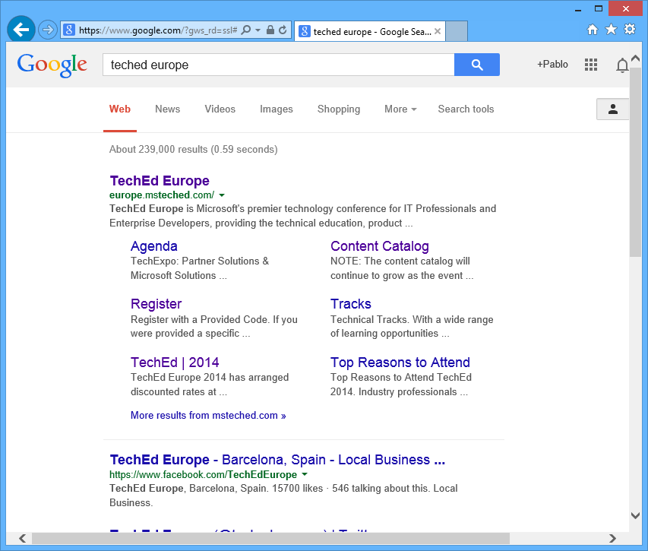
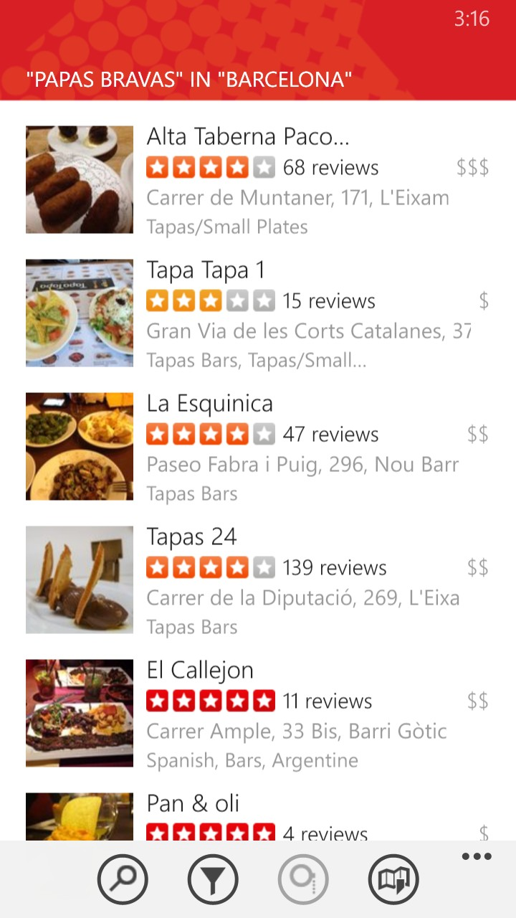

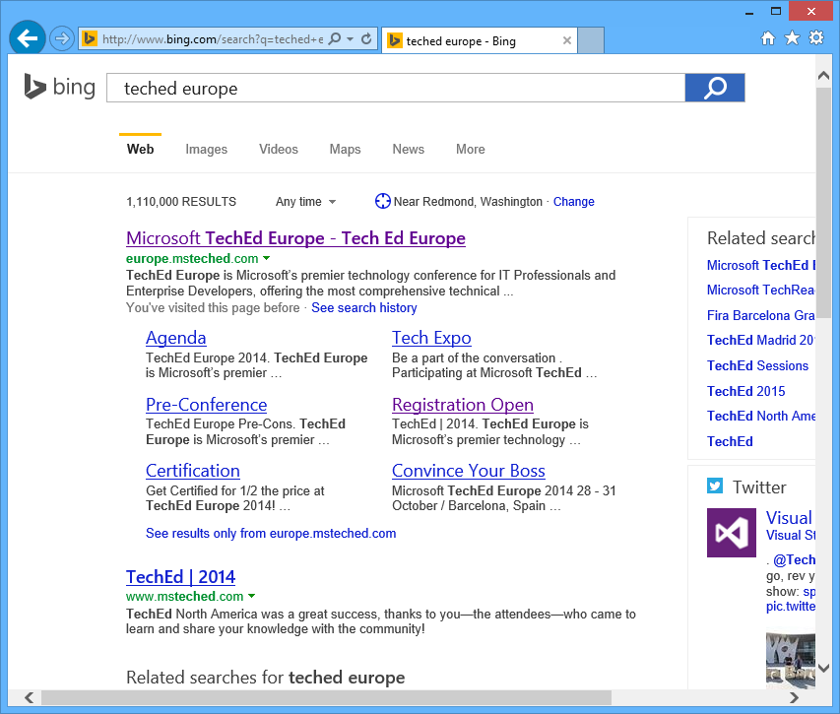
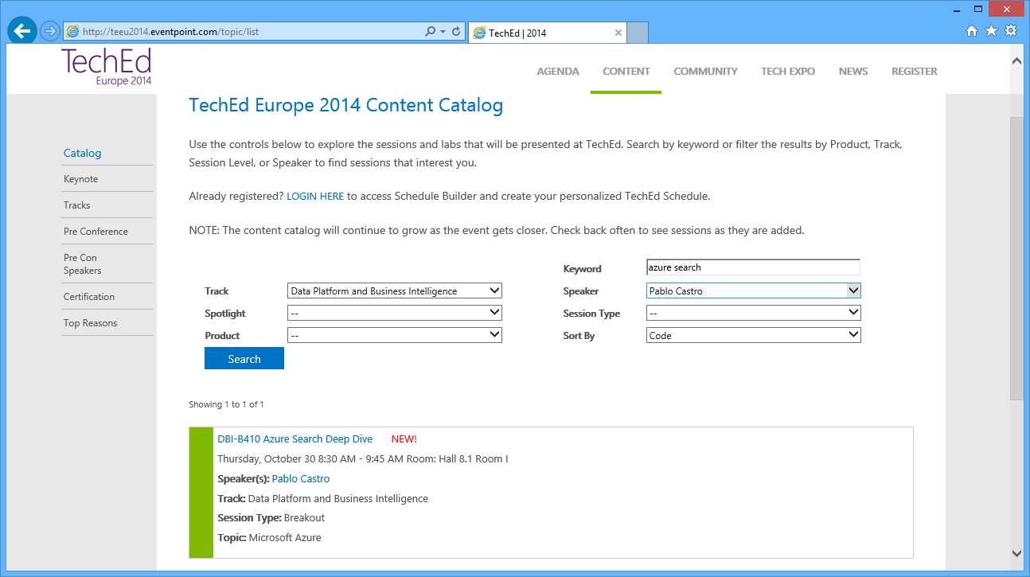
When you need to find something…
Search the Web
Search in an App

Slide 2
Azure Search
A search-as-a-service solution allowing developers to incorporate great search experiences into applications without managing infrastructure or needing to become search experts.

Slide 3
Provision service
Create index
Index data
Search

Slide 4
“Search service”
Scope for capacity
Bound to a region
Has keys, indexes, indexers, data sources
Provisioning
Azure Portal
Azure resource management API
Elastic scale
Capacity can be changed dynamically
Replicas ~ more QPS, HA
Partitions ~ more documents, write throughput
Provision service
Create index
Index data
Search

Slide 5
“Index”
Container for data, think “table”
Has schema, CORS options, search options
Create in portal or during app initialization
Typical schema
Fields definition: name, type, key
Search specifics
Field attributes – searchable, facetable, etc.
Linguistics and analysis
Suggesters for auto-complete
Scoring profiles for ranking tuning
Provision service
Create index
Index data
Search

Slide 6
Linguistics
Linguistics are key in search
Support for 50 languages
Word breaking, stop words, inflections
Lucene analyzers
Well-known analyzer stack
Stemming
Microsoft analyzers
Same NLP stack used by parts of Office, Bing
Lematization in many languages

Slide 7
Push - using indexing API
POST to /indexes/<name>/docs/index
Up to 1000 actions per batch
Actions can be upload, merge, delete, etc.
WebJobs are great for regular execution
Pull - using indexers
Azure SQL DB and DocumentDB
Change detection, deletion markers
Point it at the data source, define policy, done
Provision service
Create index
Index data
Search

Slide 8
Search + typical data operations
Simple search options, + - * () “”
Filter, sort, project, page over results
Options work with search and suggest
Search from client or server
Use query keys when searching from clients
CORS allows direct calls from browsers
Render from search results
Include necessary non-searchable data
E.g. URLs for pictures, keys to main content
Provision service
Create index
Index data
Search

Slide 9
Geospatial
Full geospatial support built-in
Store
Geography point instances as GeoJSON
Query
Filter by distance and bounding box
Sort by distance
Ranking
Boost items based on distance

Slide 10

Personalizing and Tuning

Slide 11
Custom relevance
Scoring profiles
Field weights
Scoring functions
magnitude, freshness, distance, tags
3 main patterns
Known data directly available in the index
Personalization using tag boosting
Analytics, compute externally and push to the index

Slide 12
(3,6) Search requests hit index
(1) Original data is indexed
DocumentDB collection
Web site and mobile backend
(2) Users generate traffic
Search Index
Hadoop cluster
(5) Computed signals merged into index
(4) Request, behavior logs

